Slide 1
Ingenion Telemetry Web Server Ryan Flinchum, Hamilton Henneberg, Jack Capuano, Ricky Nelson, Conrad Prisby, Thomas Swenson, Morgan Smith

Slide 2
Project Vision
Our goal for this project is to lay the groundwork for the enhancement of Ingenion's Total Verification System (TVS), a specialized piece of testing equipment used by NASA's Goddard Space Flight Center to simulate, test, and verify the functionality of satellite hardware components. We plan to add features and functionality to this system by implementing a Xilinx MicroBlaze soft-core CPU on top of the onboard Artix 7 FPGA, running FreeRTOS, an open-source real-time operating system, which will host an interactive web server, which will be able to connect to an external computer using TCP over Ethernet, which will have the capabilities of reading and displaying telemetry from the onboard AXI bus and other peripherals, as well as send various commands to the CPU. This system will first be implemented on the Digilent Nexys A7 development board, and then ported over to the TVS in the form of a plug-and-play package.

Slide 3
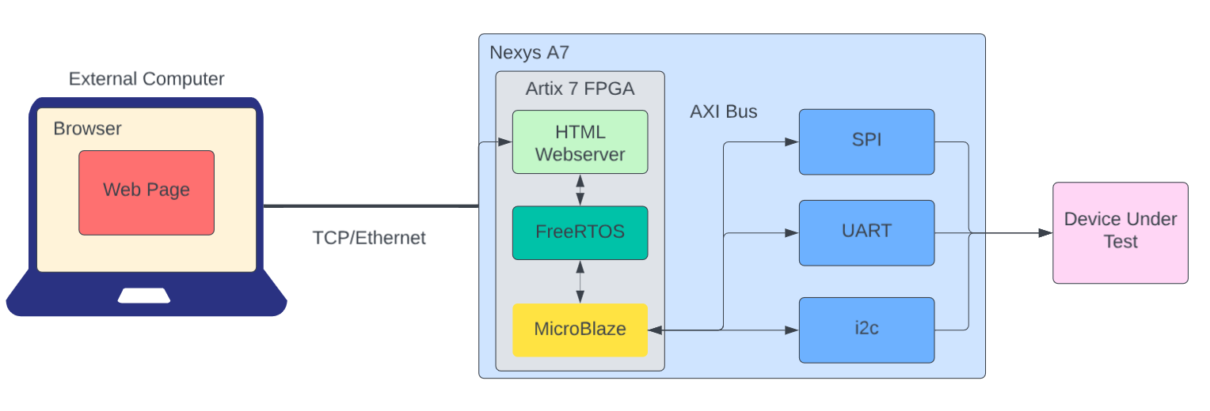

Slide 4
Customer needs
Develop HDL for AXI control over additional peripherals
Display AXI packet data within HTML server
Command Telemetry Interface (Software control over AXI peripherals)
Server needs to be hosted on FreeRTOS Operating System and MicroBlaze soft-core CPU.

Slide 5
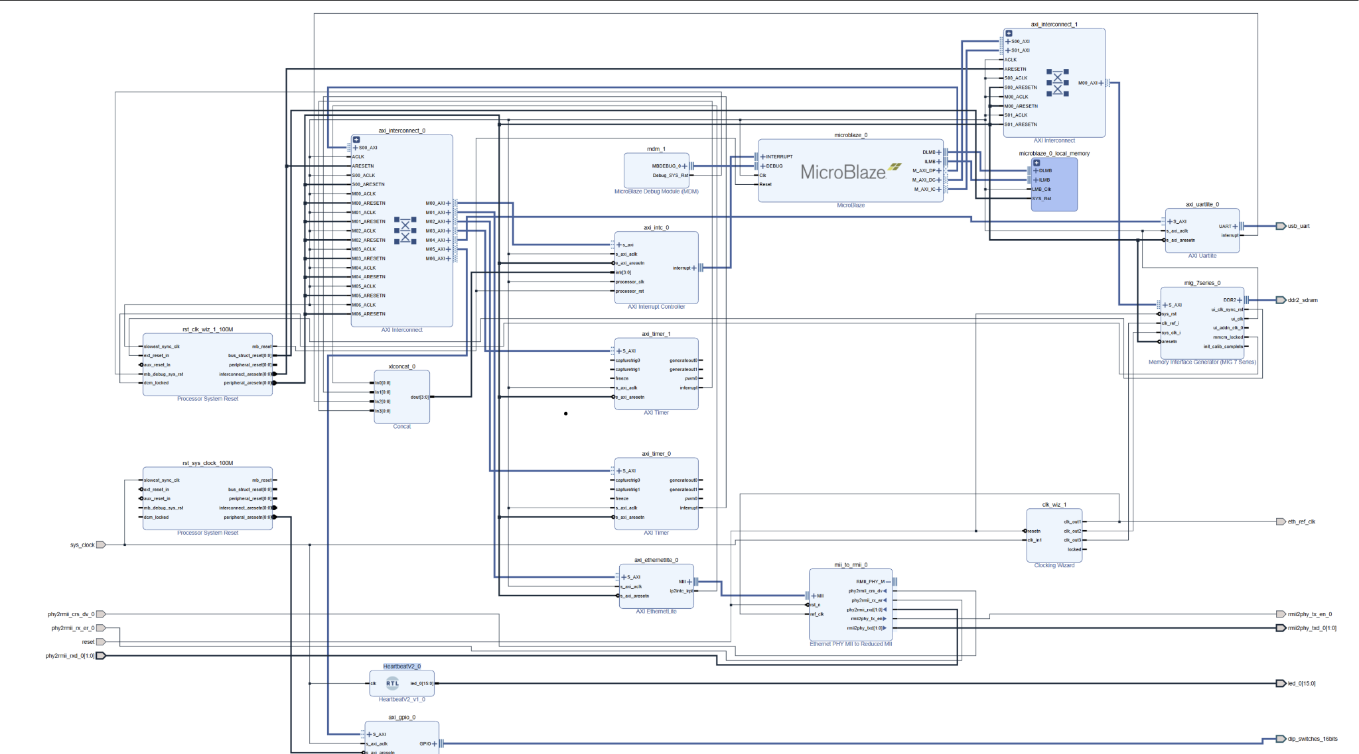
HDL Block Design

Slide 6
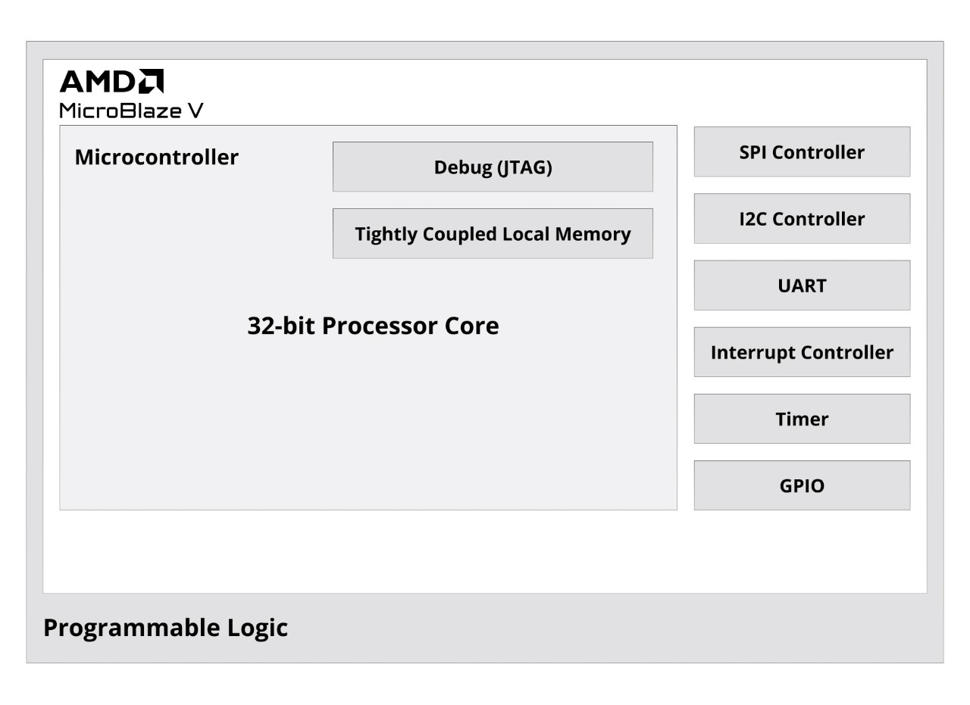
MicroBlaze
Softcore Processor that sits on top of the Artix 7 FPGA
Successfully built Nexys A7 Microblaze Bitfile and programmed FPGA
Implementation Complete as far as base CPU and necessary IP Cores
Need to integrate other additional IP cores and integrate them into current MicroBlaze Design

Slide 7
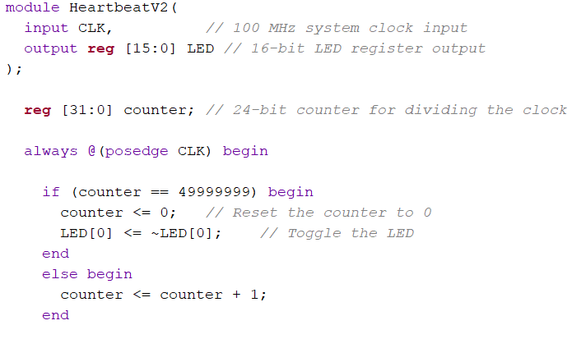
Verilog (HDL) Coding
Example of Verilog (HDL - Hardware design language) code
Uses wires, registers, runs off of clock edges
Directly defines the board’s hardware configuration, setting bits to 0 or 1, etc
Notes:
jack

Slide 8
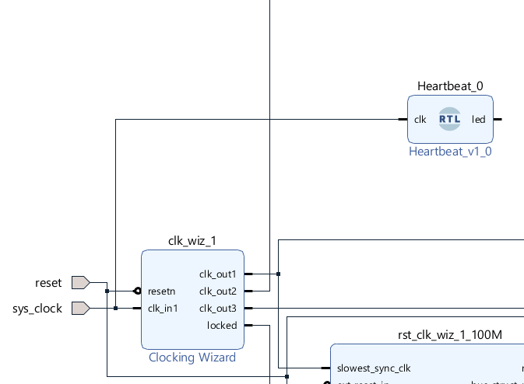
1 PPS “Heartbeat” Module
Module designed to visually show the uptime of the program
Achieved via LED pulsing for 1 second on, 1 second off
Uses the system clock for timing
Connects to board hardware via external outputs:
Output connects to the register that directly controls the board’s LEDS
Notes:
jack

Slide 9
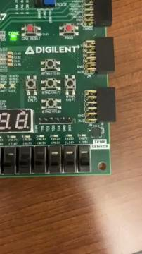
Notes:
jack

Slide 10
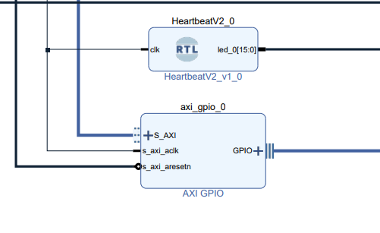
GPIO Module
Utilize GPIO for seamless data transfer between HTML and hardware.
Integrate switches for interactive control and data I/O.
Enable real-time interaction using GPIO for responsive functionality.
Implement a user-friendly HTML interface for intuitive hardware control.
IP Added / MicroBlaze Connection In-Progress

Slide 11
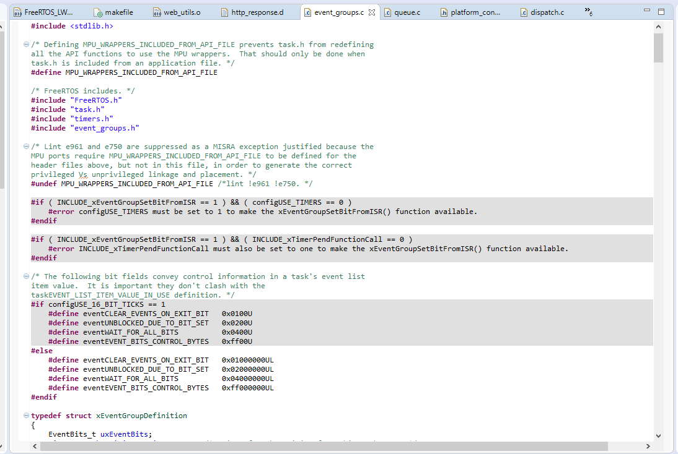
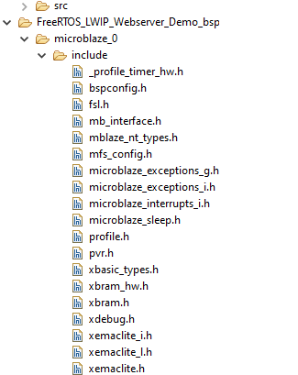
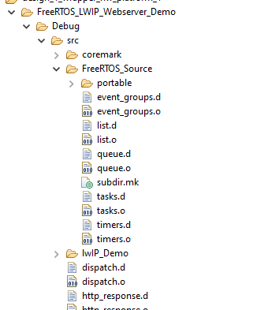
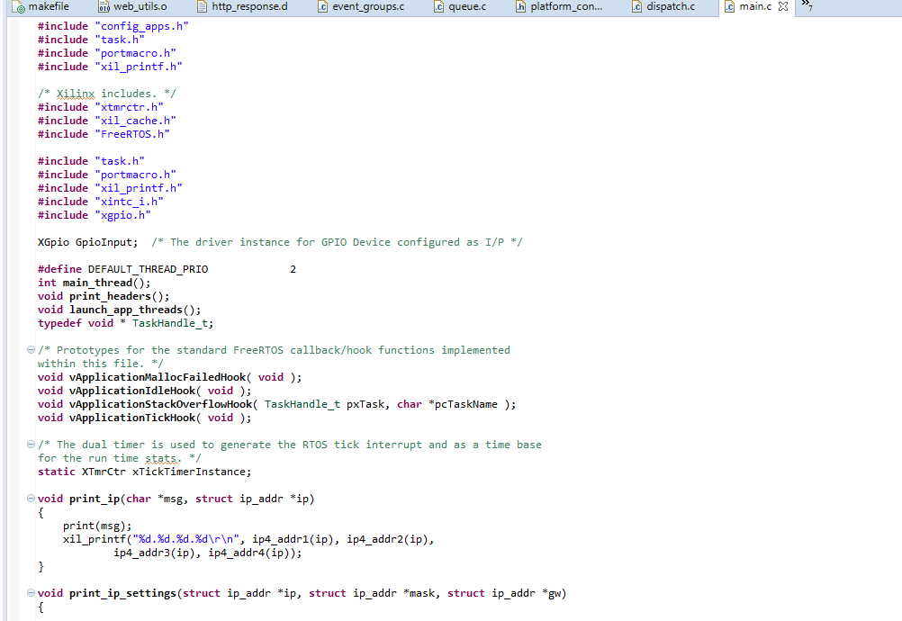
FreeRTOS
Successfully Built and Ran FreeRTOS ‘hello world’ Program in Simulation
Have Successfully Rebuilt LWIP Webserver Demo in SDK
Have yet to receive output through actual hardware / still debugging

Slide 12
HTML Web Pages
Renovated outdated web-server tutorial
Interfaces to the FPGA I/O through js which handles asynchronous XMLHttpRequest(s)
Uses ActiveXObject("Microsoft.XMLHTTP") for older browsers
Uses a dynamic interaction with a server where different LED tests can be triggered based on user input
Update images with each button press
The script uses states to handle a variety of incoming requests and responses
“readystate”
“onreadystatechange”

Slide 13
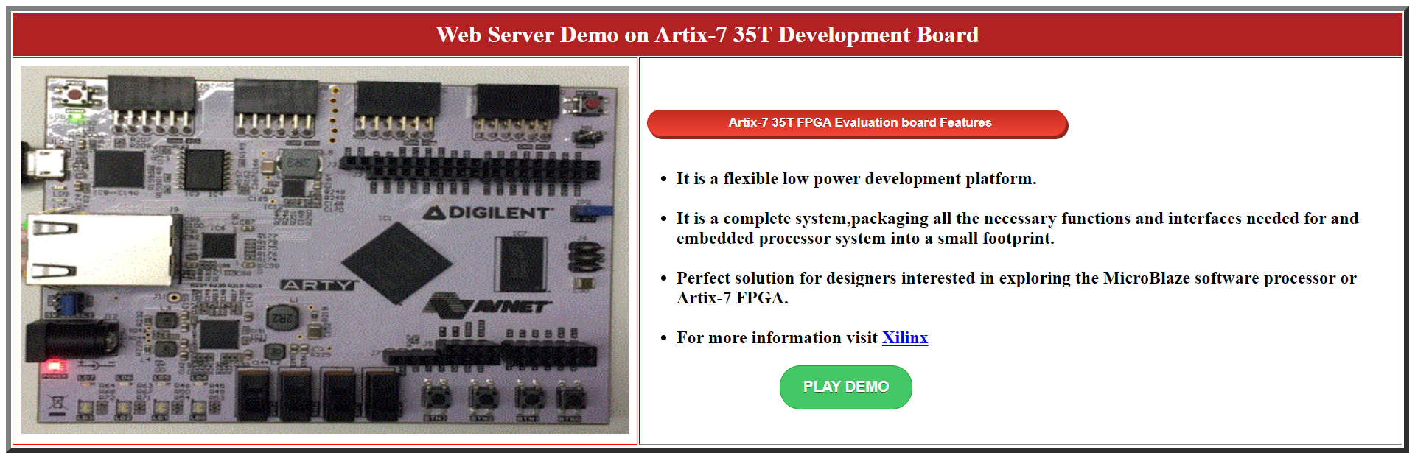
Original HTML Template Design

Slide 14
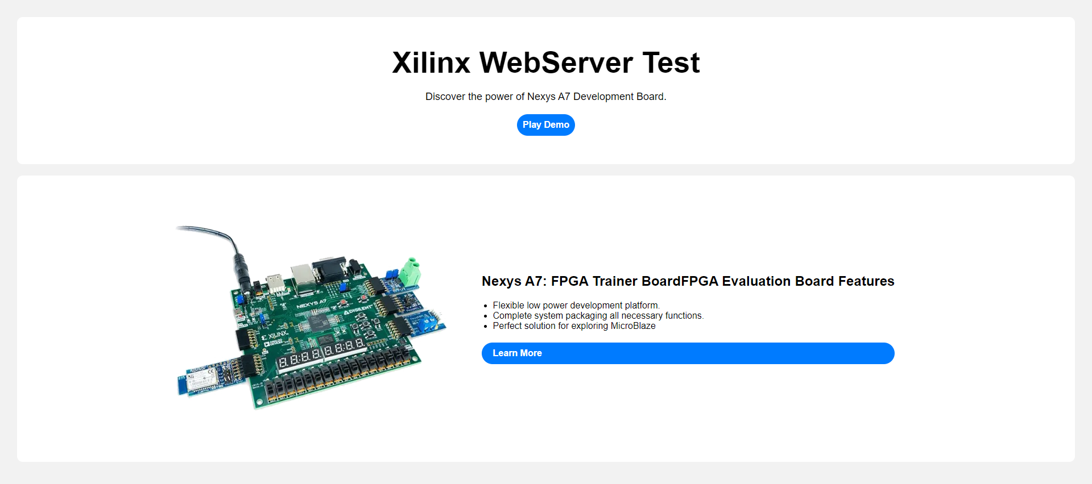
New HTML Design

Slide 15
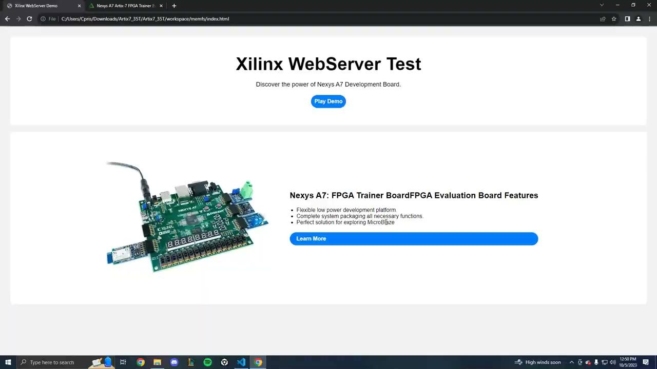
HTML Demo

Slide 16
Challenges
Technical difficulties (Mac, old laptop)
Steep learning curve for Xilinx SDK and FPGA IP Block Connections
Large backlog items/tasks
Communication

Slide 17
Lessons Learned From This Semester
Need for active communication from customer
Requirements should be more specific and thorough
Strong encouragement is needed to meet deadlines / more effective scheduling
Large overarching Backlog Items should be broken into smaller actionable tasks

Slide 18
Next Semester Backlog
Test RTOS and code on Microblaze design
Implement command telemetry interface and display telemetry on web server
Write an RTOS task for parsing ethernet packets
Test AXI control over GPIO

Slide 19
Questions?

